Slide 1
Model Interpretation
using
LIME and SHAP
By
Komal Joshi
Anagha Sethuraman
Neha Poonia
Akash Kuratkar
Aditya Baravkar

Slide 2
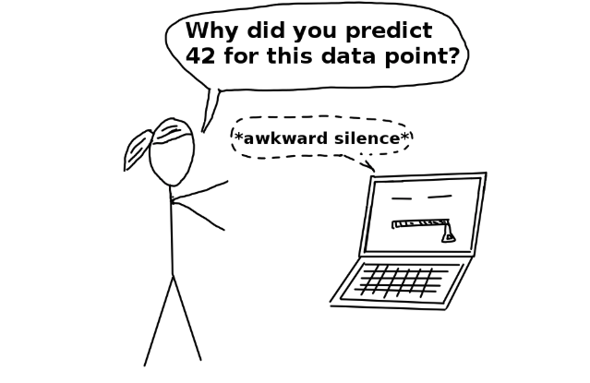
Motivation behind model interpretability
Business Impact
Regulatory Concern

Slide 3
What is model interpretability?
Interpretability is the degree to which a model's predictions can be explained in straightforward human terms.

Slide 4
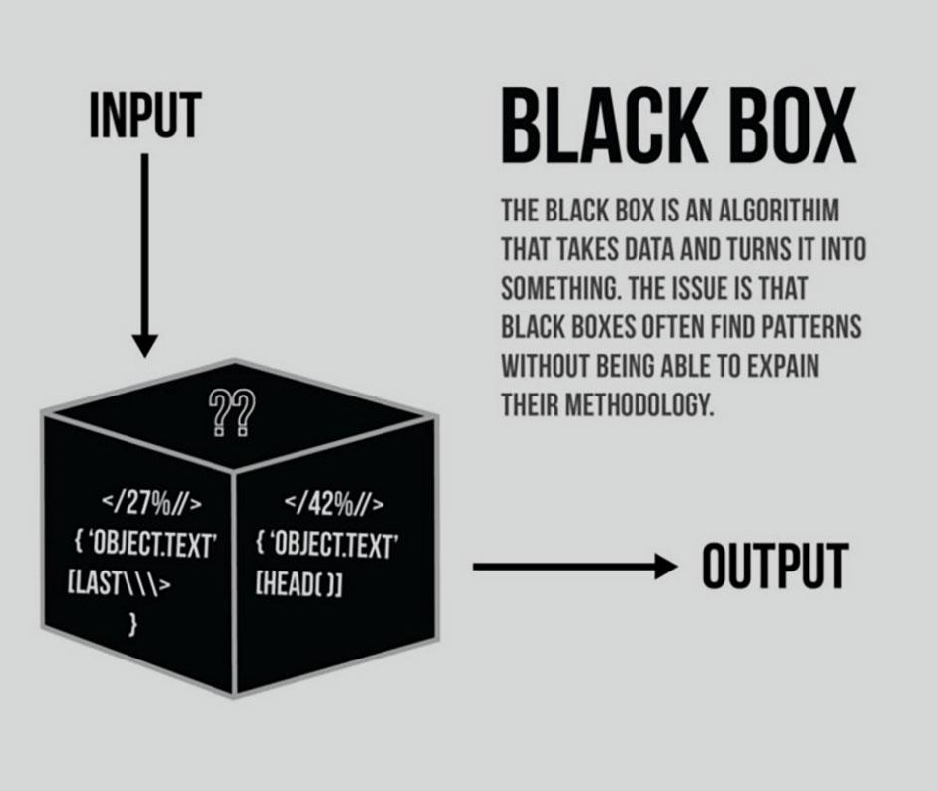
Problem with black box models

Slide 5
Why is interpretability in machine learning important?
Neha Poonia

Slide 6


Slide 7
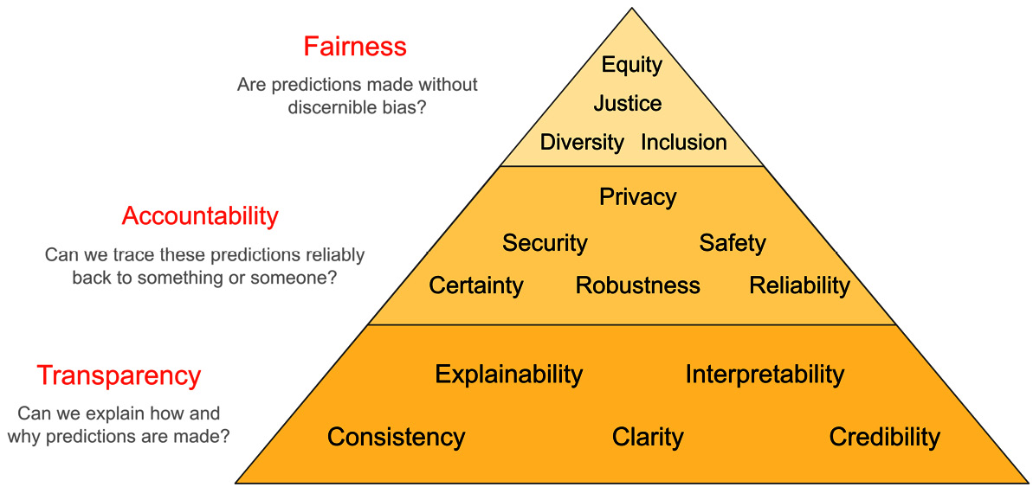
Need of interpretability
What drives model predictions?
Why did the model take a certain decision?
How can we trust model predictions?

Slide 8
Traditional Techniques for Model Interpretation
Exploratory Analysis and Visualization
Dimensionality reduction
Manifold Learning
Variational autoencoders
Clustering
Model performance evaluation metrics
Supervised Learning — Classification
Supervised Learning — Regression
Unsupervised Learning — Clustering

Slide 9
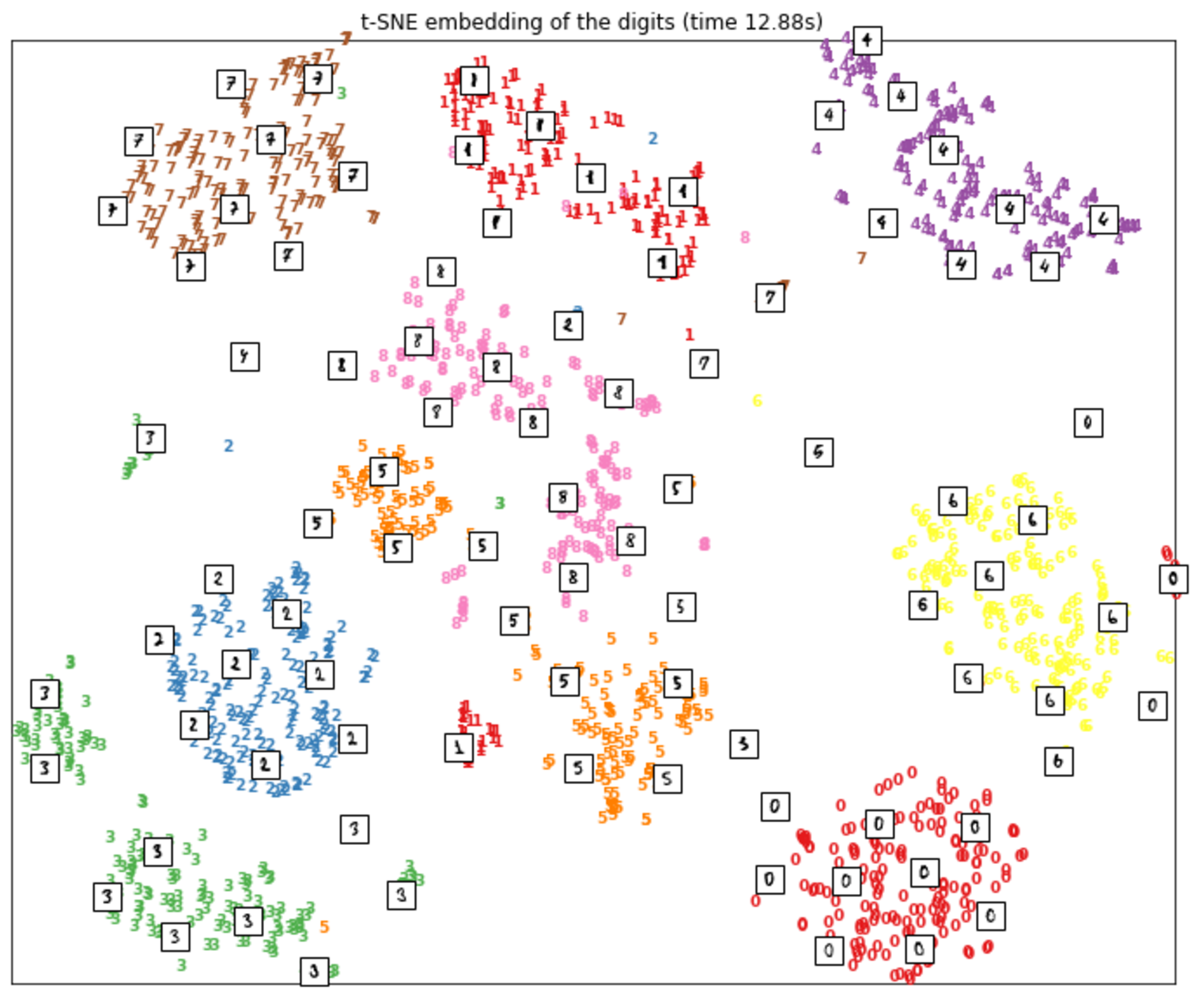
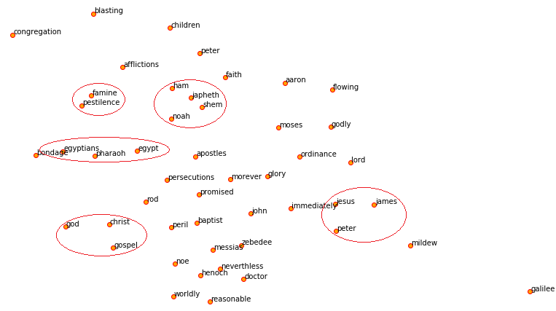
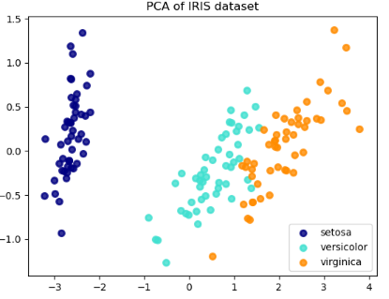
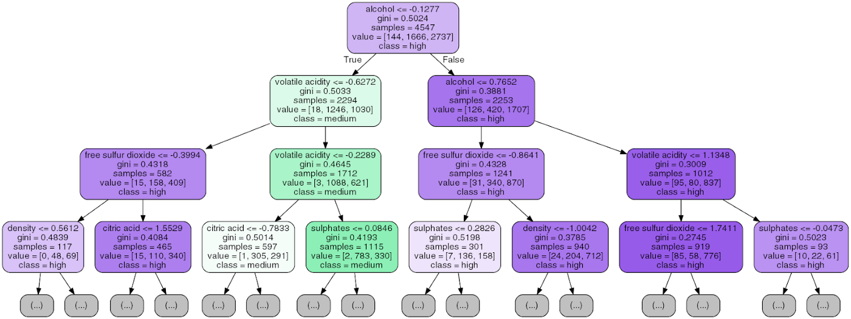
Exploratory Analysis and Visualization
Visualizing MNIST data using t-SNE using sklearn.
Visualizing word embeddings using t-SNE
Principal Component Analysis on the IRIS dataset
Visualizing human-interpretable rules for a decision tree model

Slide 10
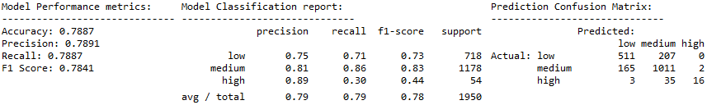
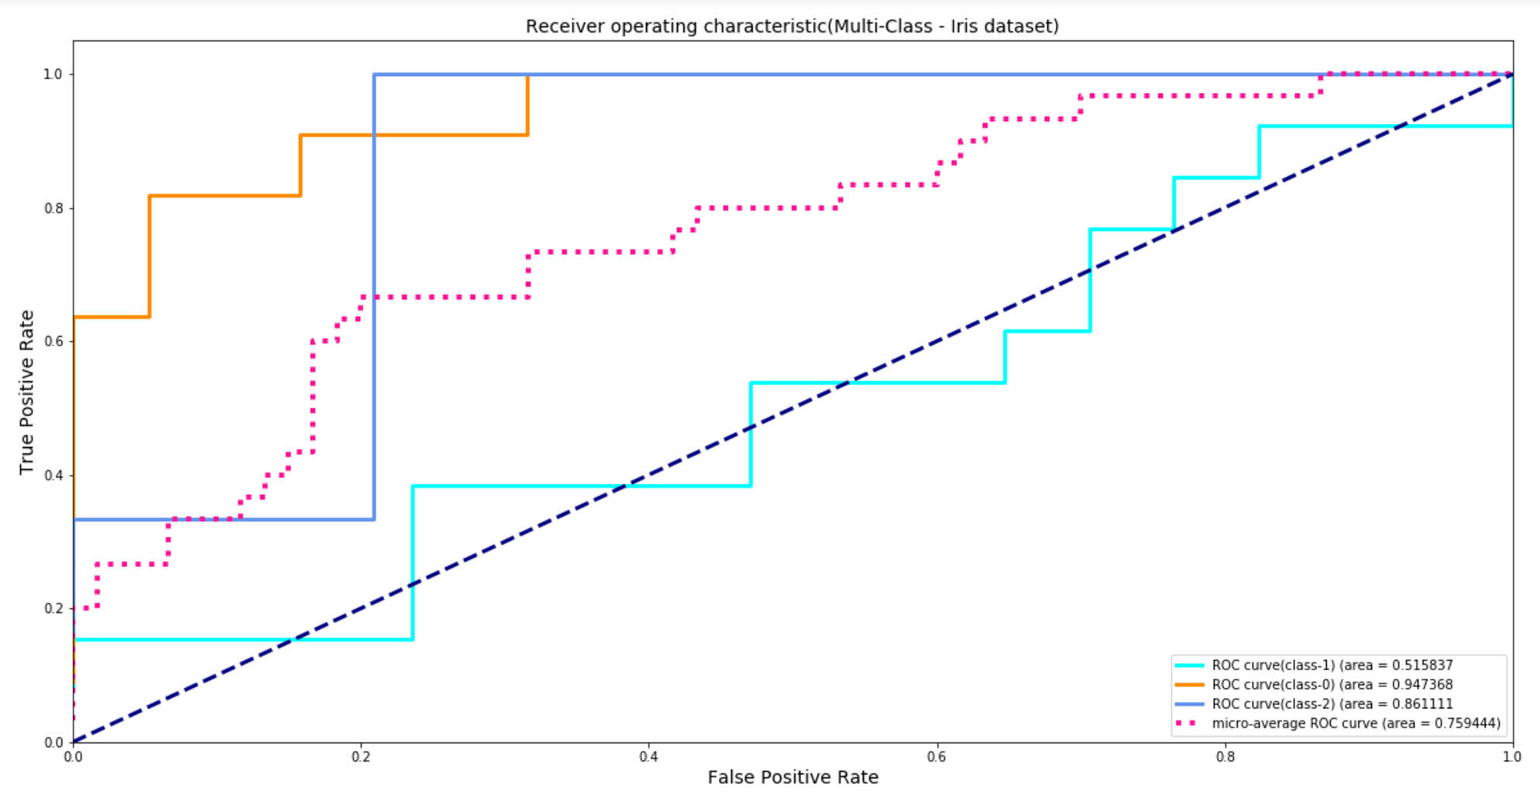
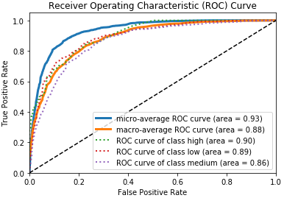
Model performance evaluation metrics
Classification Model Performance Metrics
Measuring model performance by computing the area under the receiver operating characteristic curve (ROC curve) on the Iris data set, using sklearn for a multi-class problem
ROC Curve and AUC scores

Slide 11
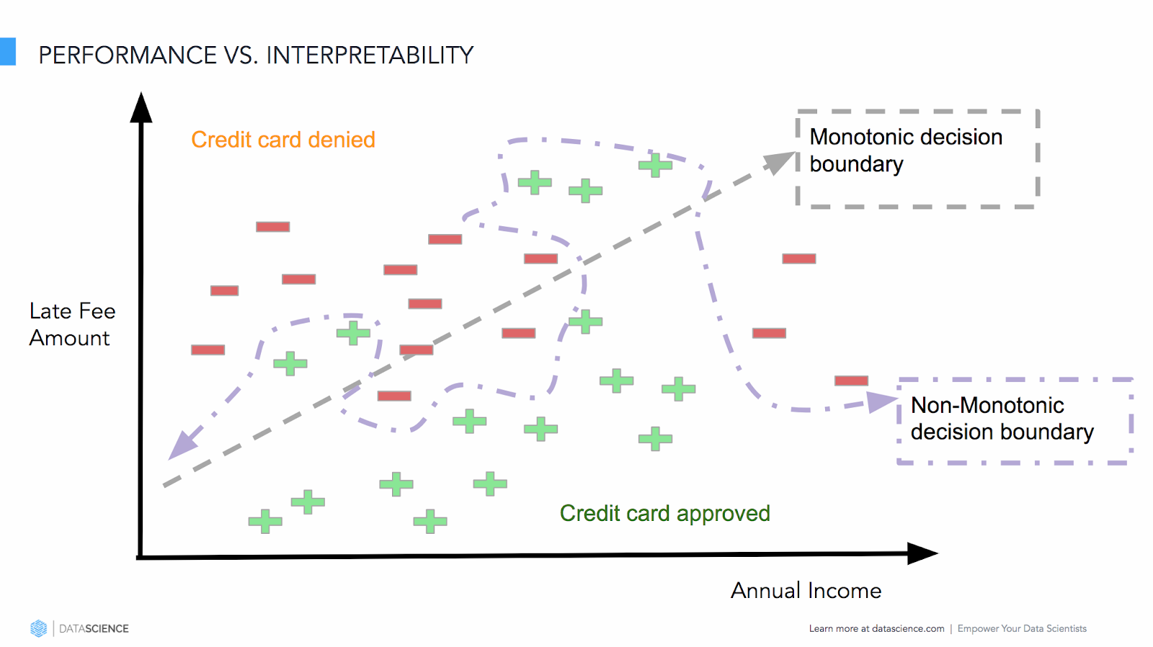
Accuracy vs. Interpretability Trade-off
Model performance vs. interpretability

Slide 12
Model Interpretation Using
LIME
Komal Joshi (014682551)

Slide 13
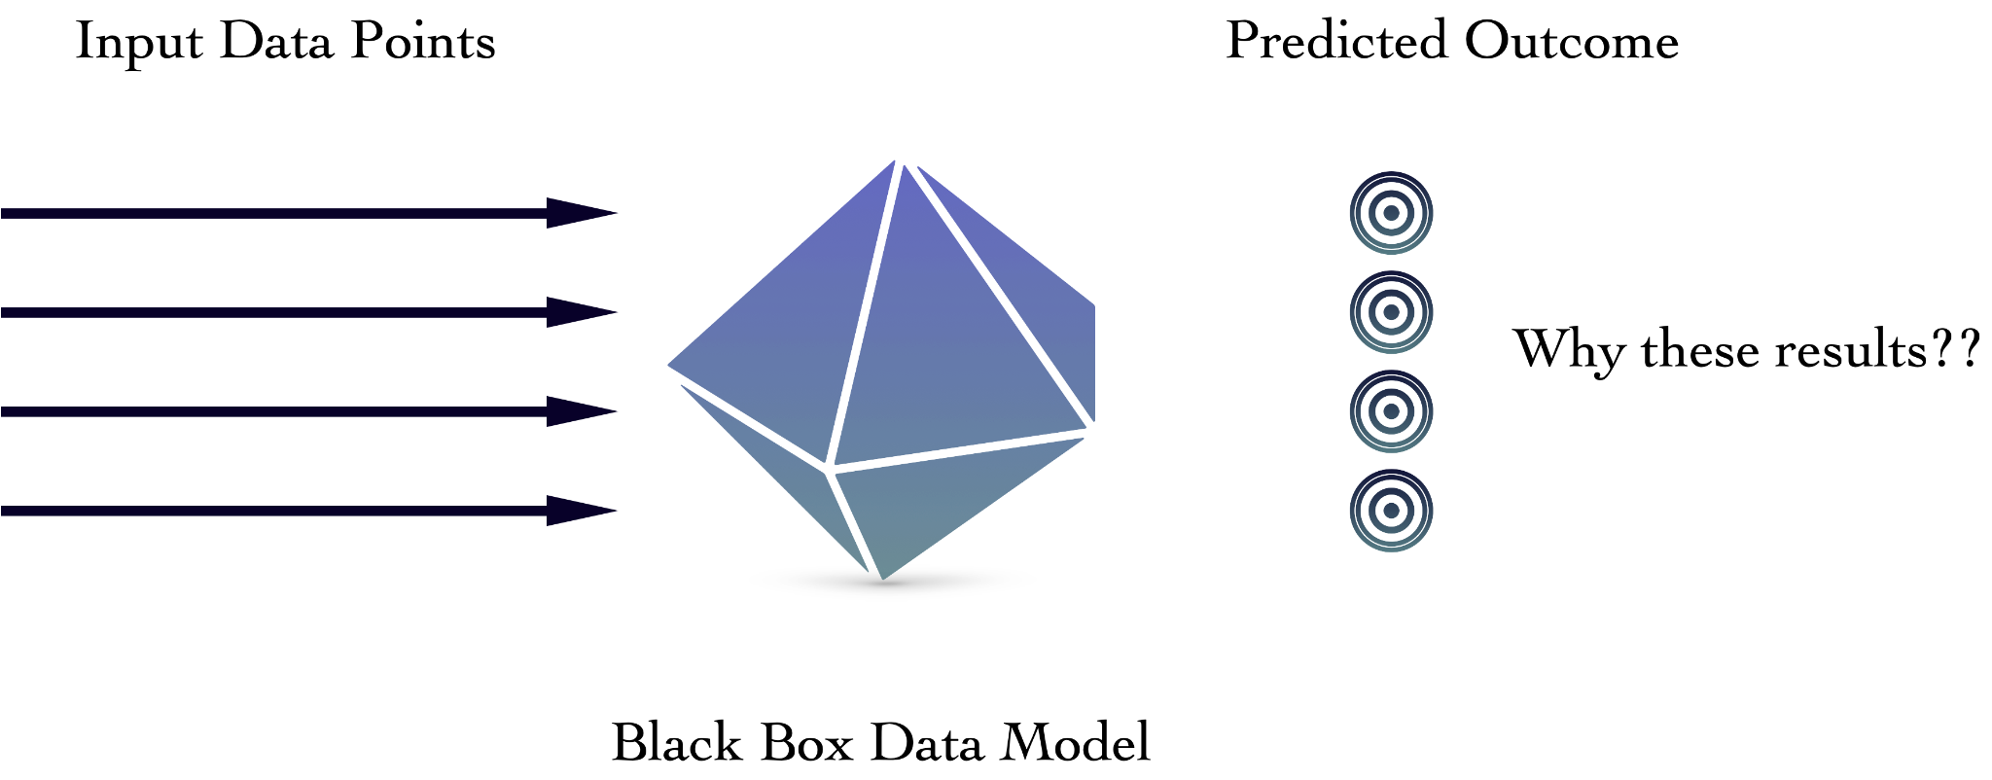
WHY TRUST BLACK BOX?

Slide 14
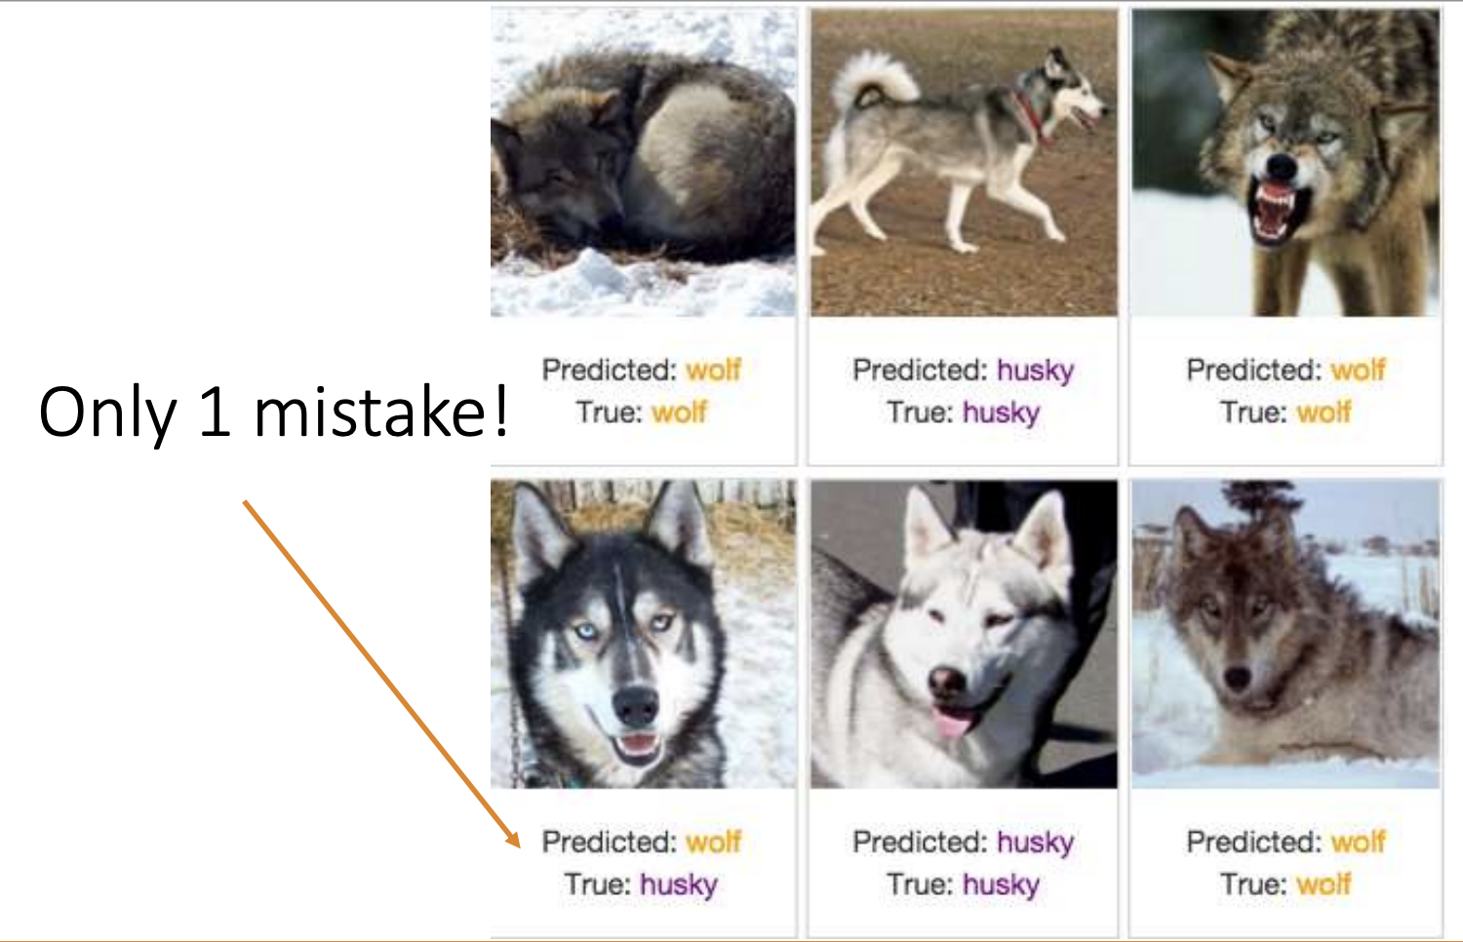
WHY TRUST BLACK BOX?

Slide 15
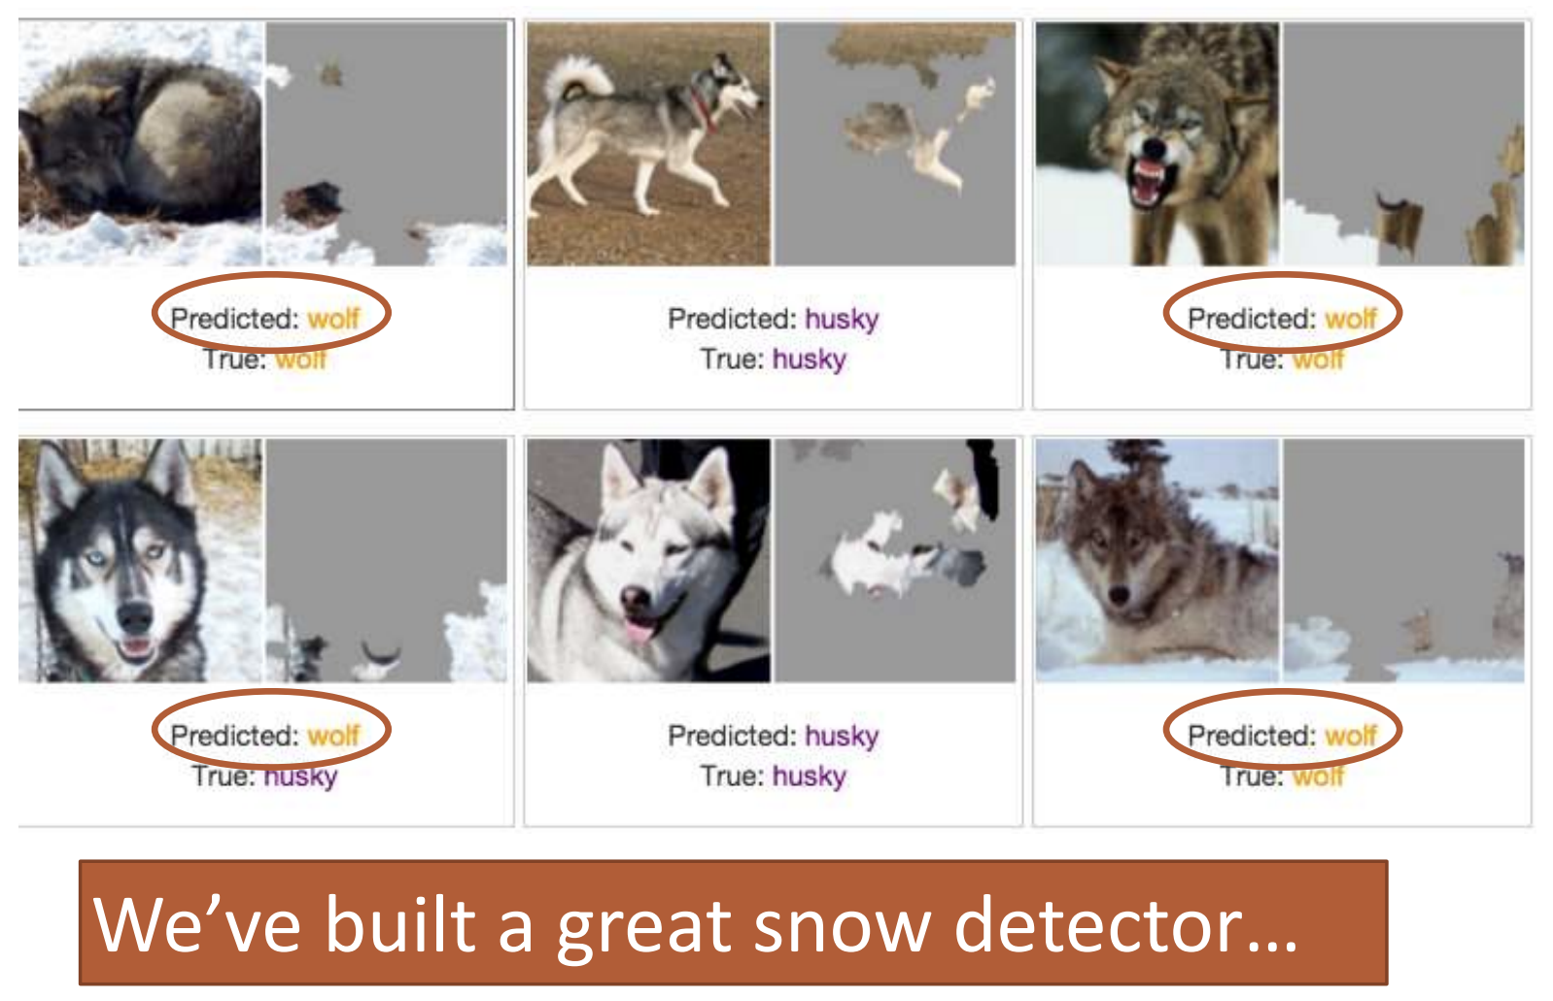
WHY TRUST BLACK BOX?

Slide 16
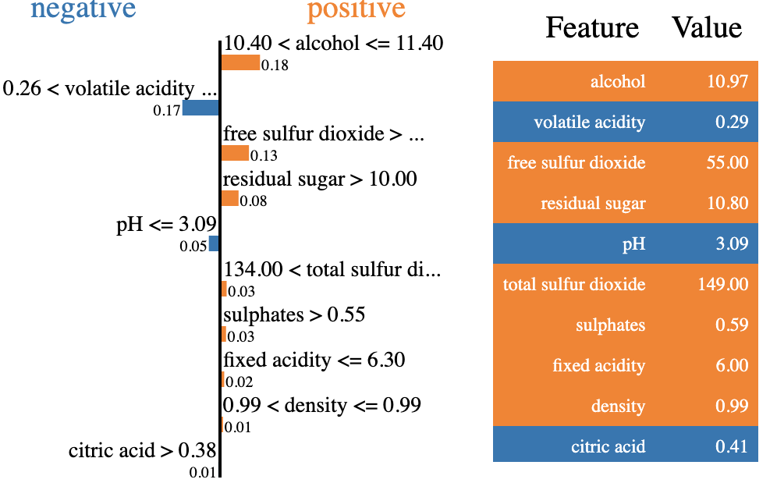
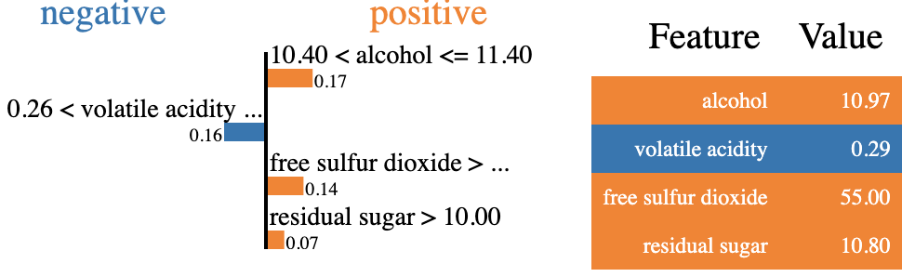
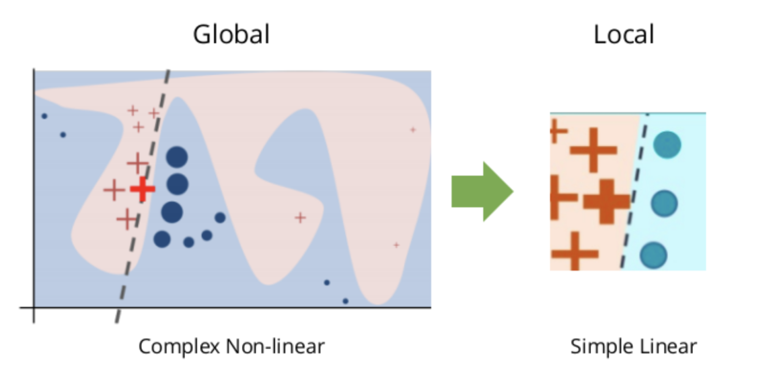
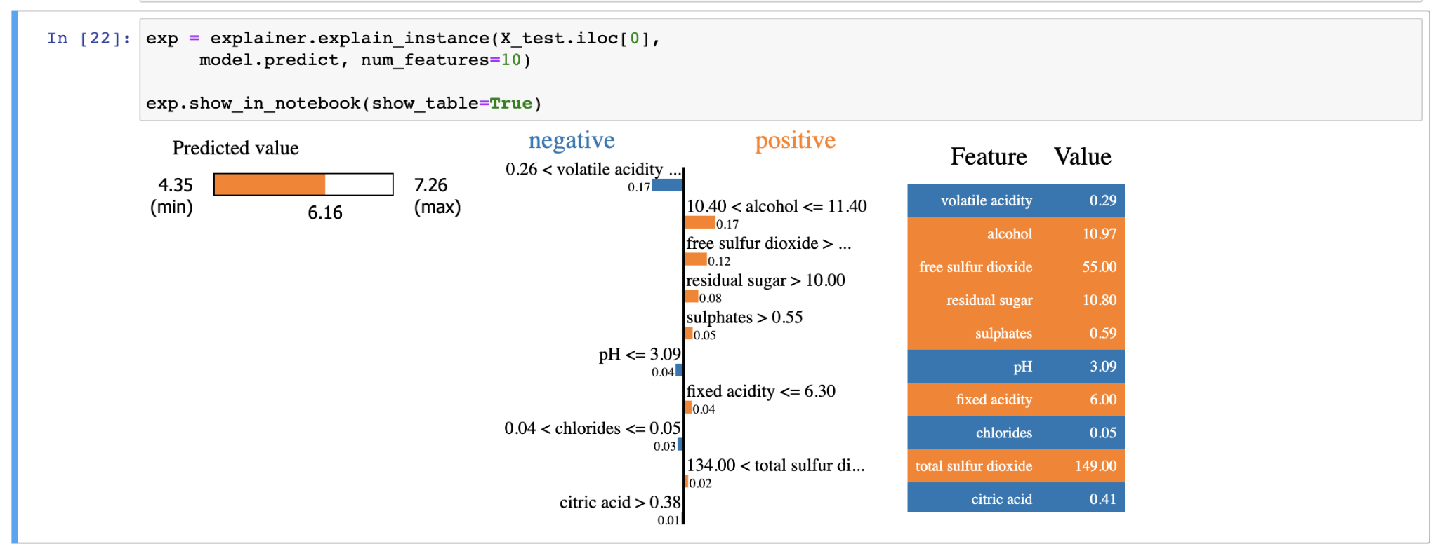
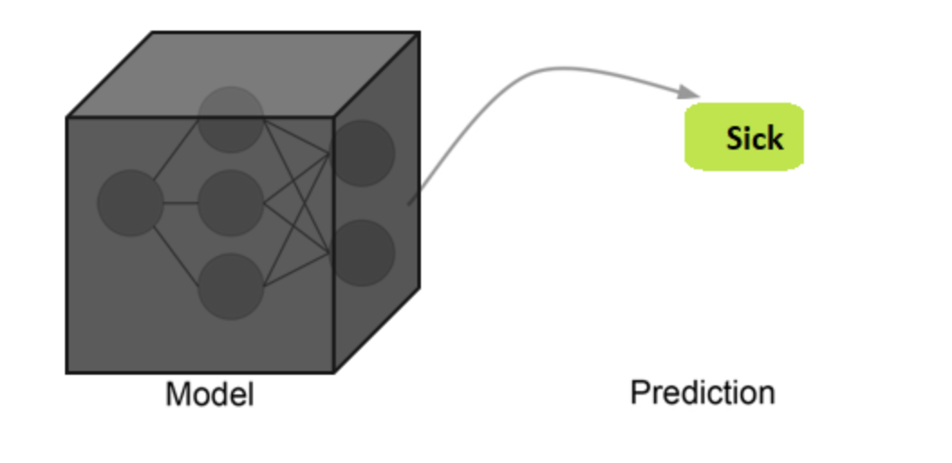
LIME
Locally faithful
Interpretable
Model- agnostic
Explananable

Slide 17
LIME - GENERAL IDEA
Get Instance Variable Of interest.
Perturb data and get black box predictions
Weight data set as per proximity
Train weighted model
Get explanations from interpreted model

Slide 18
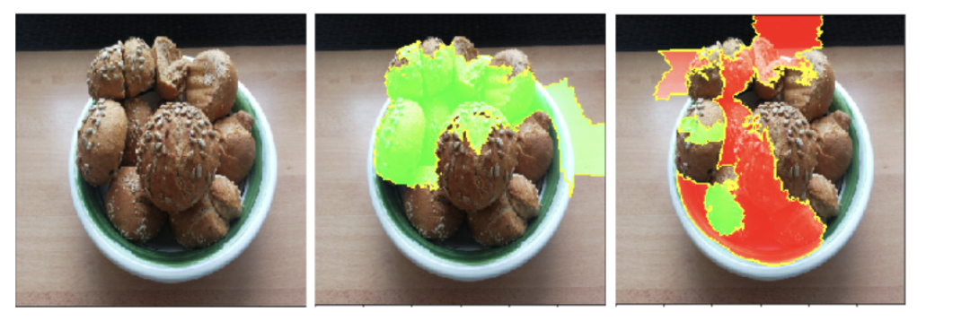
WHERE IS LIME USED?
Lime for Image
Bread or Strawberry?
Segment image into super pixels
Turn super pixels off/on
Lime for Text
Randomly Remove text from instance

Slide 19
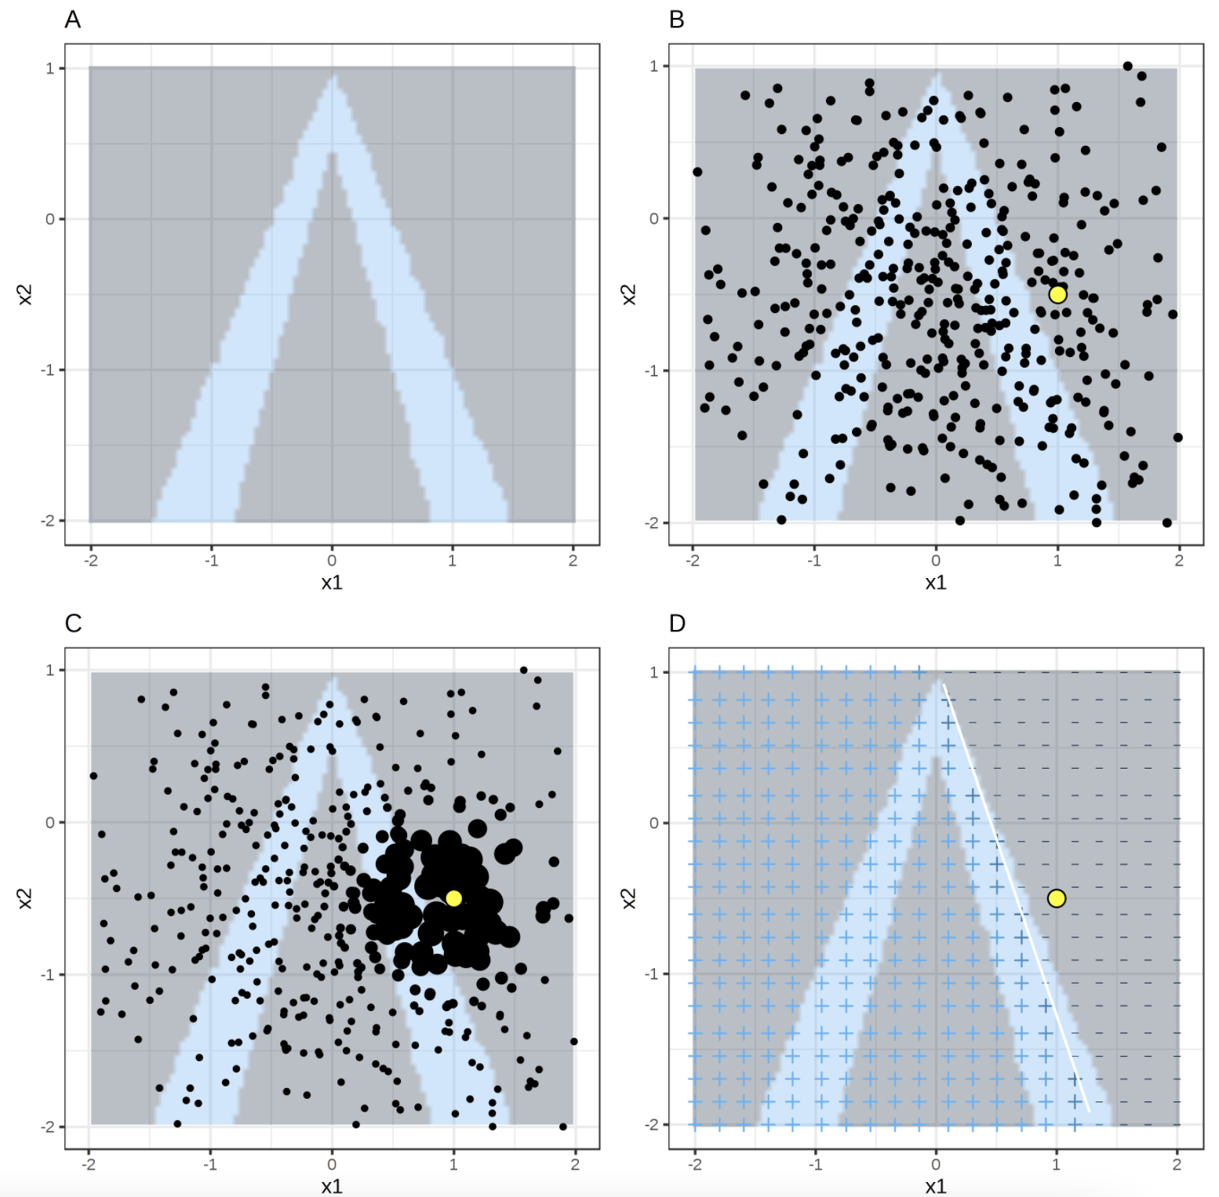
WHERE IS LIME USED?
Lime for Tabular
Features x1 and x2
A: Class 1(dark) and 0(light)
B: LIME samples taken from mass center
C: Weight data in proximity
D: Learned Model based on weighted data

Slide 20
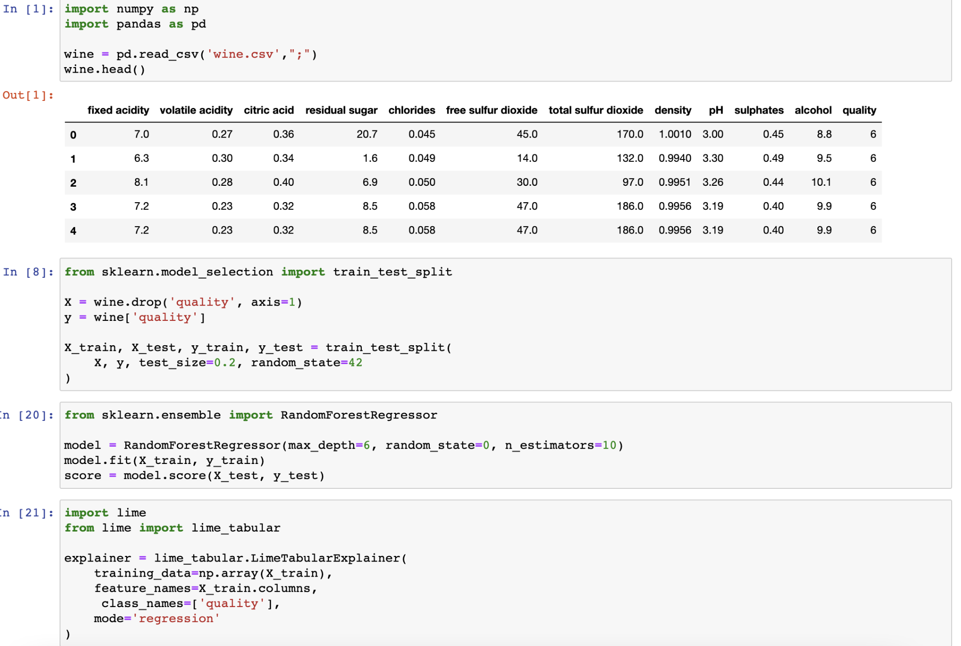
READ AND TRAIN DATA

Slide 21
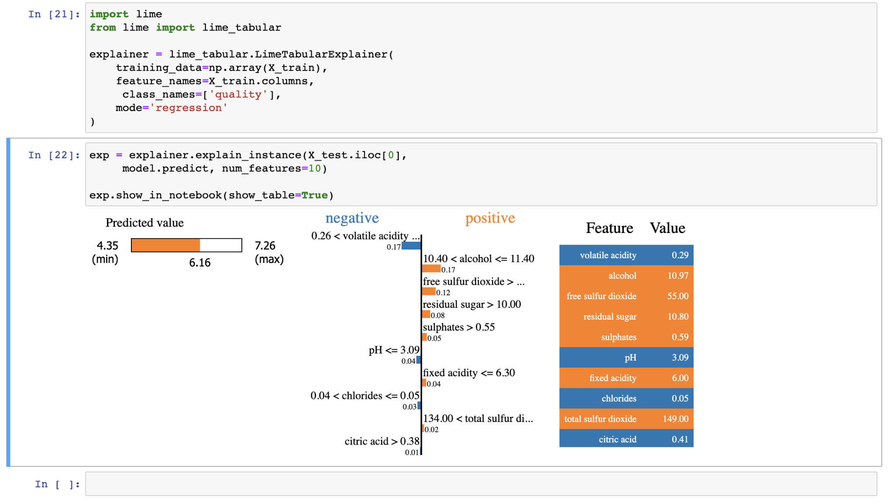
LIME in ACTION
Perturb features
Regression Mode: gives predicted values
Learn locally weighted model
Visualize result

Slide 22
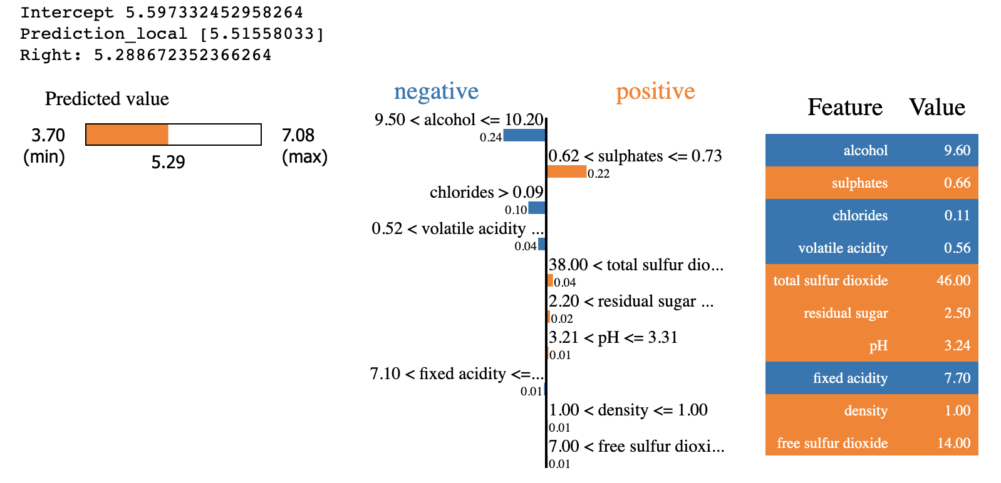
Visualize Result

Slide 23
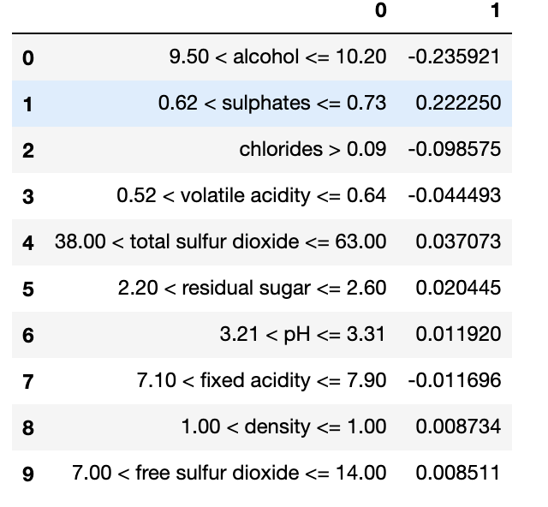
Visualize Result

Slide 24
Model Interpretation Using
SHAP
Akash Kuratkar

Slide 25
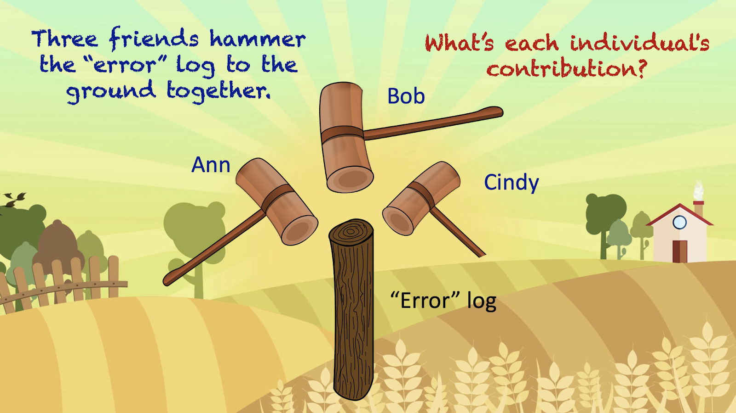
SHAP(SHapley Additive exPlanations)
What is SHAP ?
SHAP (SHapley Additive exPlanations) by Lundberg and Lee, is a method to explain individual predictions.
Based on Game theory.
a theoretical framework for social situations.
> Game
> Player
> Payout(Reward)
How can we allocate this profit such that each person is fairly rewarded commensurate to their actual contribution?

Slide 26
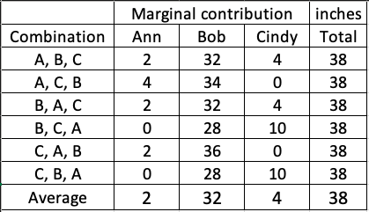
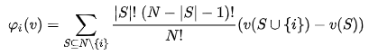
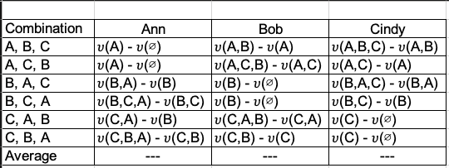
Shapley Values
the average marginal contribution of a feature value across all possible coalitions.
Formula:
Axioms to achieve a fair contribution:
Efficiency
Symmetry
Dummy
Additivity

Slide 27
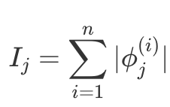
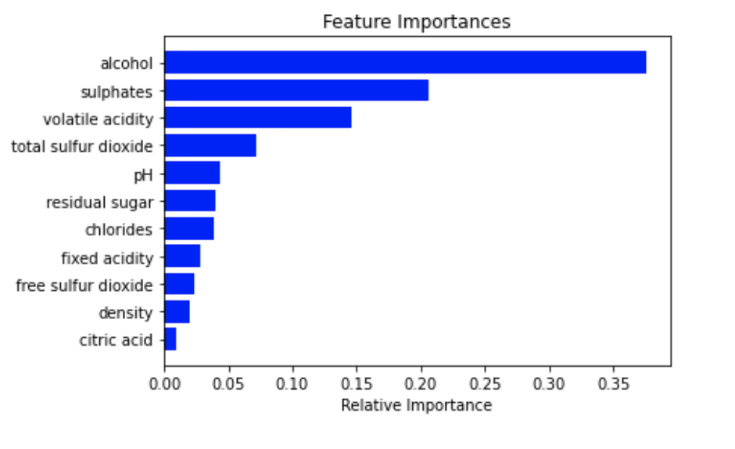
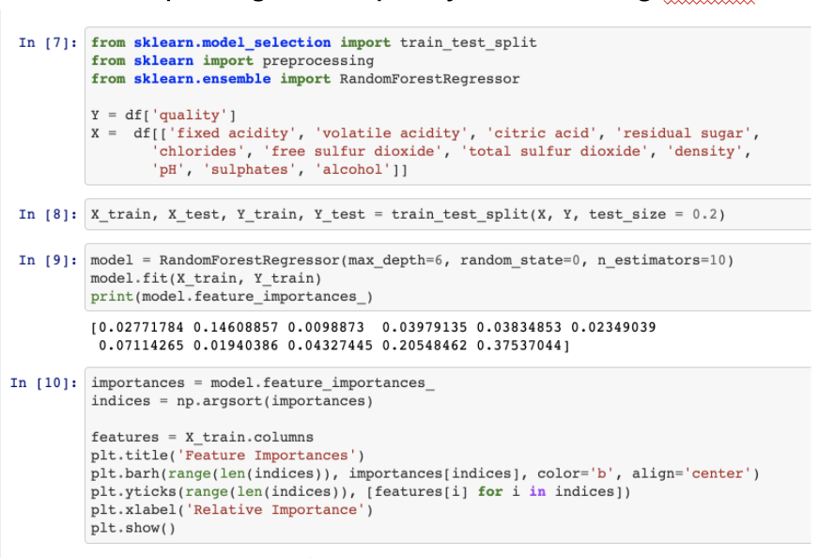
SHAP Feature Importance:
Features with large absolute Shapley values are important.
Interpreting Wine quality model using SHAP

Slide 28
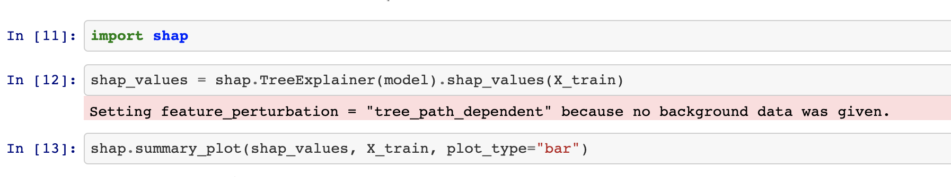
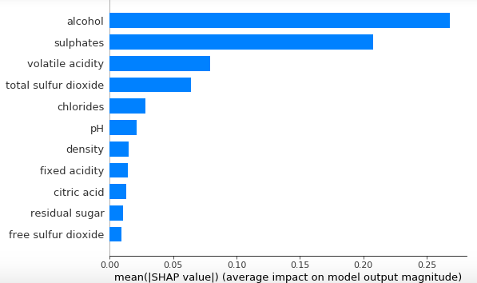
SHAP Feature Importance:
Can the variable importance plot show the directions between the features and the target variable?

Slide 29
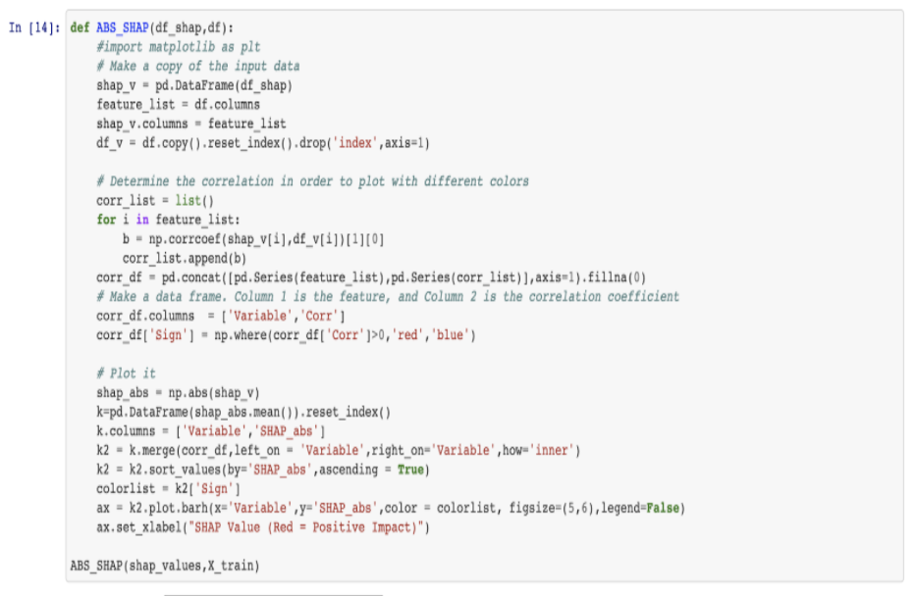
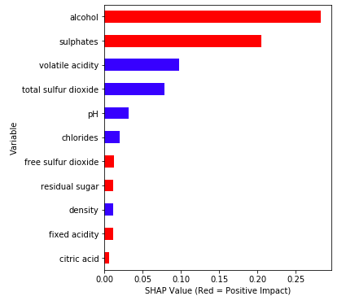
SHAP Summary Plot
Feature importance
Impact
Original value
Correlation

Slide 30
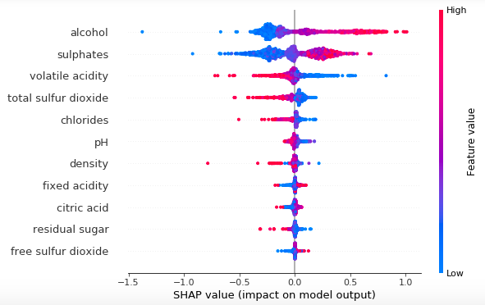
SHAP Summary Plot

Slide 31
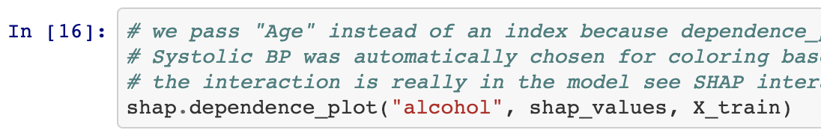
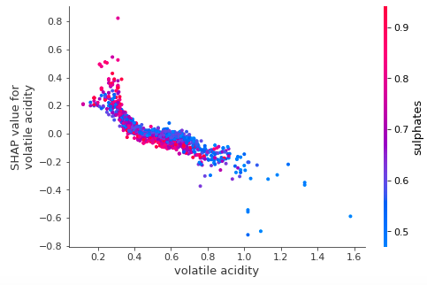
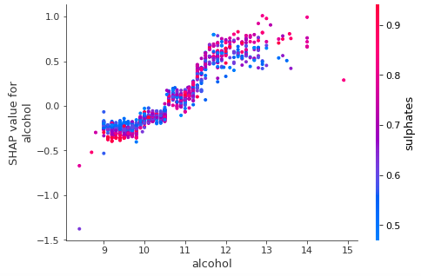
SHAP Dependence Plot
Shows the marginal effect of features on predicted outcome.

Slide 32
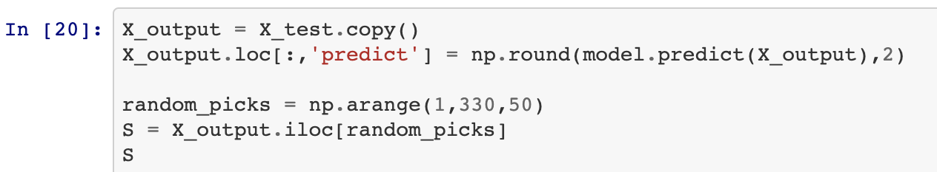
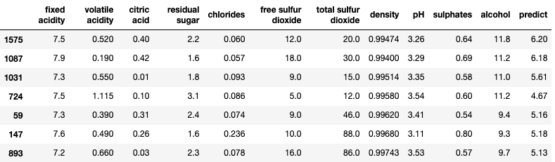
SHAP Individual Value Plot

Slide 33
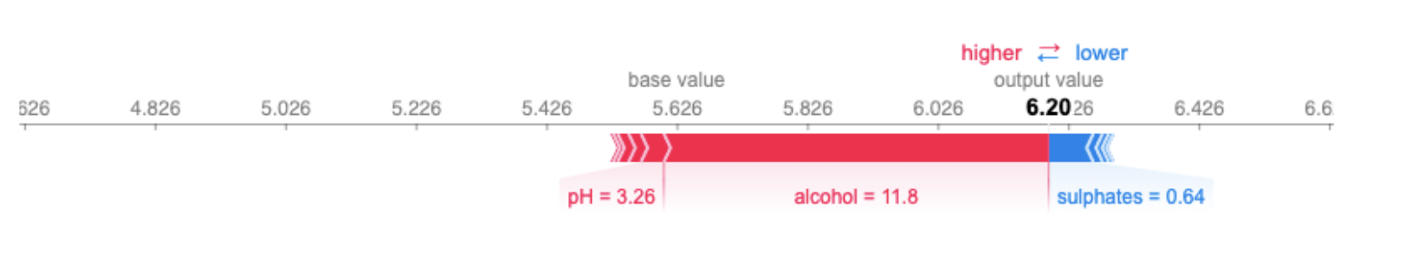
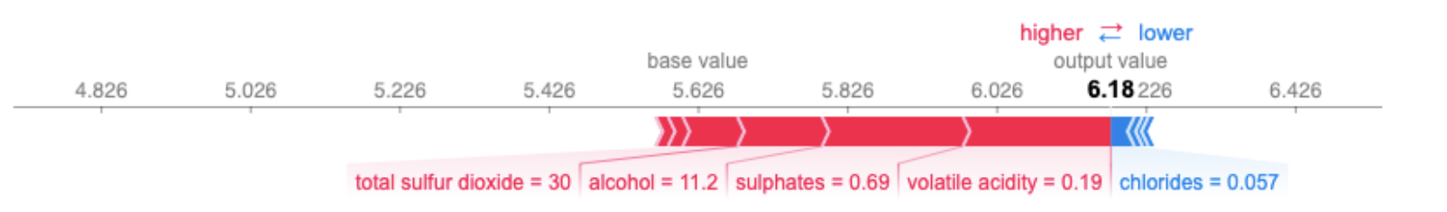
SHAP Individual Value Plot
Observation 1
Observation 2

Slide 34
Why should we use Shapley values
Local Accuracy
Consistency
Types of explanations:
Tree Explainer
Deep Explainer and Gradient Explainer (Neural Networks)
Kernel Explainer

Slide 35
Lime and Shap
Comparison
Anagha Sethuraman

Slide 36
Based on the wine prediction example, we can compare Lime and Shap.
Prediction explanation with LIME

Slide 37
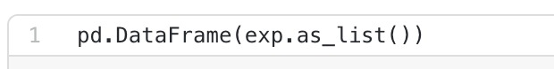
We can list the coefficients using the above command and this provide better looking visualizations.

Slide 38
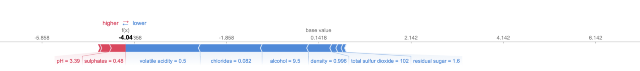
Prediction explanation with Shap
The visualizations isn’t as interpretable as one made by Lime.The red marks push the prediction higher towards the base value, and the blue marks do just the opposite.
For the wine dataset — if you see more blues than reds, the wine is classified as bad and vice versa.

Slide 39
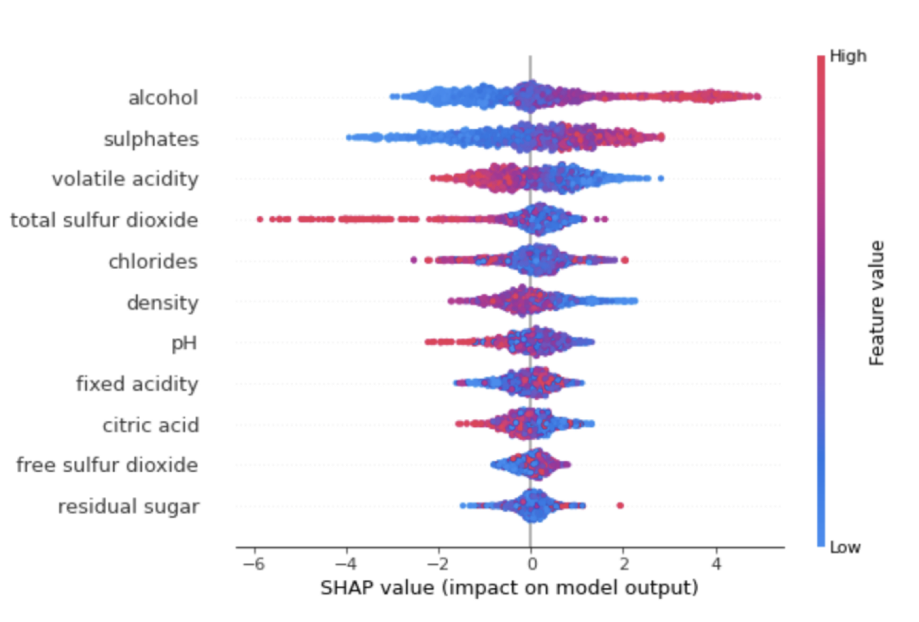
Shap comes with summary plots - a neat way to visualize every feature importance and their impact on prediction.
SHAP doesn’t look as intuitive as LIME out of the box. It comes with summary charts that make understanding an entire machine learning model easy.

Slide 40
LIME vs. SHAP: Which is Better for Explaining Machine Learning Models?
SHAP and LIME are both popular Python libraries for model explainability.
Use LIME for single prediction explanation
Use SHAP for entire model (or single variable) explanation(SHAP mostly for summary plots and dependence plots).

Slide 41
Lime : Advantages
Lime is fast and simple method for explaining black box models.
Good-looking Visuals.
Lime can be used when SHAP’s compute costs are too high.
LIME is one of the few methods that works for tabular data, text and images.
LIME is implemented in Python (lime library) and R (lime package and iml package) and is very easy to use.
Advantages of Shap over Lime
Shapley value guarantees a fair distribution of contribution for each of the variables (LIME do not provide the guarantee).
SHAP connects LIME and Shapley values. This is very useful to better understand both methods.
LIME assumes that the local model is linear, SHAP does not have any such assumptions.
SHAP value is NOT the difference between the prediction with and without a variable, rather it is a contribution of a variable to the difference between the actual prediction and the mean prediction.

Slide 42
Limitations of Lime and Shap
Lack of stability
LIME depends on the ability to perturb samples in meaningful ways.
Lack of Consistency.
Lime doesn’t work out-of-the-box on all models.
SHAP depends on background datasets to infer a baseline/expected value. For large datasets, it is computationally expensive.
KernelSHAP is slow.
KernelSHAP ignores feature dependence.
The disadvantages of Shapley values also apply to SHAP

Slide 43
Conclusion
In the above slides we saw two implementations of model interpretability, LIME and SHAP. Depending on the task at hand both or either tools could be used to increase model interpretability.
SHAP might be more theoretically rigorous and stable, however if time is of the essence, LIME might be enough to begin interpreting your model predictions.

Slide 44
References
https://towardsdatascience.com/lime-vs-shap-which-is-better-for-explaining-machine-learning-models-d68d8290bb16
https://www.slideshare.net/0xdata/explaining-blackbox-machine-learning-predictions/37
https://medium.com/dataman-in-ai/explain-your-model-with-lime-5a1a5867b423
https://towardsdatascience.com/explainable-artificial-intelligence-part-2-model-interpretation-strategies-75d4afa6b739
https://towardsdatascience.com/human-interpretable-machine-learning-part-1-the-need-and-importance-of-model-interpretation-2ed758f5f476
https://lime-ml.readthedocs.io/en/latest/lime.html#module-lime.lime_tabular
https://christophm.github.io/interpretable-ml-book/lime.html

